Slide 1
Teen Dating
Harmless fun or Potential Danger
By
Jacobbie Jones, Hannah Grace, Madison Kasmeier

Slide 2
Teen dating a potential danger!
When teenagers begin to date they are uncertain about many things. Girls are usually the ones uncertain about things such as what to do and not to when you are in a teen relationship. Teen girls usually think that just because a boy tells her he loves her that she must do what ever he says when that’s not the case.

Slide 3
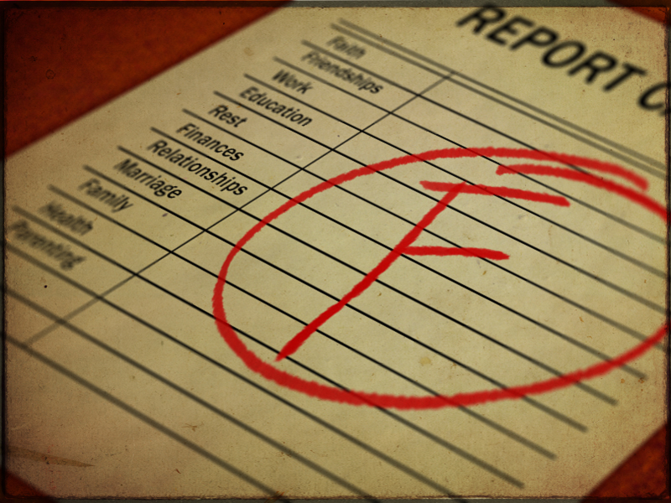
Teen dating even more of a potential danger!
When u begin to date as a teen u tend to forget about things that really matter like school. Your grades begin to fall, your start making bad decisions, and u start to blow off your real friends for your new “boyfriend ”or “girlfriend”.

Slide 4
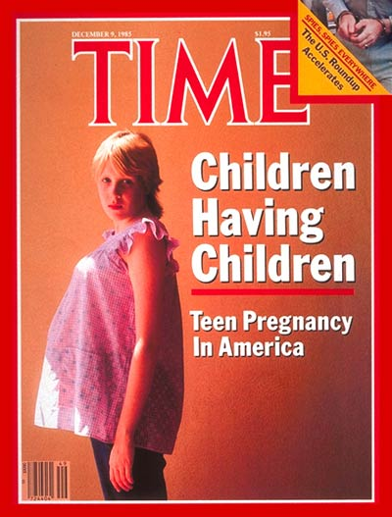
Teen dating becomes dangerous!
A big danger while dating as a teen is teen pregnancy. Teen pregnancy is becoming more and more frequent in the world today. In the U.S.A today more than half the babies being born have teen parents.

Slide 5
Solution???
There is no real solution to teen dating and how to stop, resolve, or fix the issue. The only thing u can do as a teen dater is to be responsible and think before you make a dumb mistake.

